Slide 1

Object Oriented Programming
Software tools for complex machines

Slide 2
Agenda
Object Oriented Programming
Day 1:
Day 2:
Why Object Oriented Programming
Encapsulation
Methods and Properties
Inheritance
SOLID Principles
Frameworks / Modular Programming / PackML
PackML Framework
Responsive Design
THIS pointer
Global assignmentt of IOs to instances
Interfaces
CodeSys CBM
Abstract Classes
UML

Slide 3


Why Object Oriented Programming
Object Oriented Programming
Complexity
Low technical resources
Machines are similar, but not equal
Industrial applications are becoming more complex. Batch size one, predictive maintenance, diagnostics for minimizing stopping times, cloud data register, line integration, OEE, etc…
it is difficult finding technicians for R&D and Technical Support. OOP helps to develop programs more efficiently
Need to reuse code and adapt it for new functionalities without affecting the complete machine software core.

Slide 4
Why Object Oriented Programming
Object Oriented Programming
Programmer’s teams
Technical support independent from R&D
Fast and optimal commissioning
Need of tools for code sharing between programmers. Software structure need to be the same for every machine & programmer.
Every technician should be able of providing technical support for all company machines – need for standards
Machines can be parametrizable instead of programmable. No need for programmer on machine start-up; a technician without software knowledge can configure the machine.

Slide 5
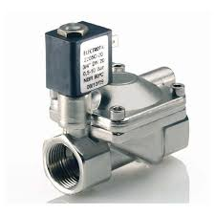
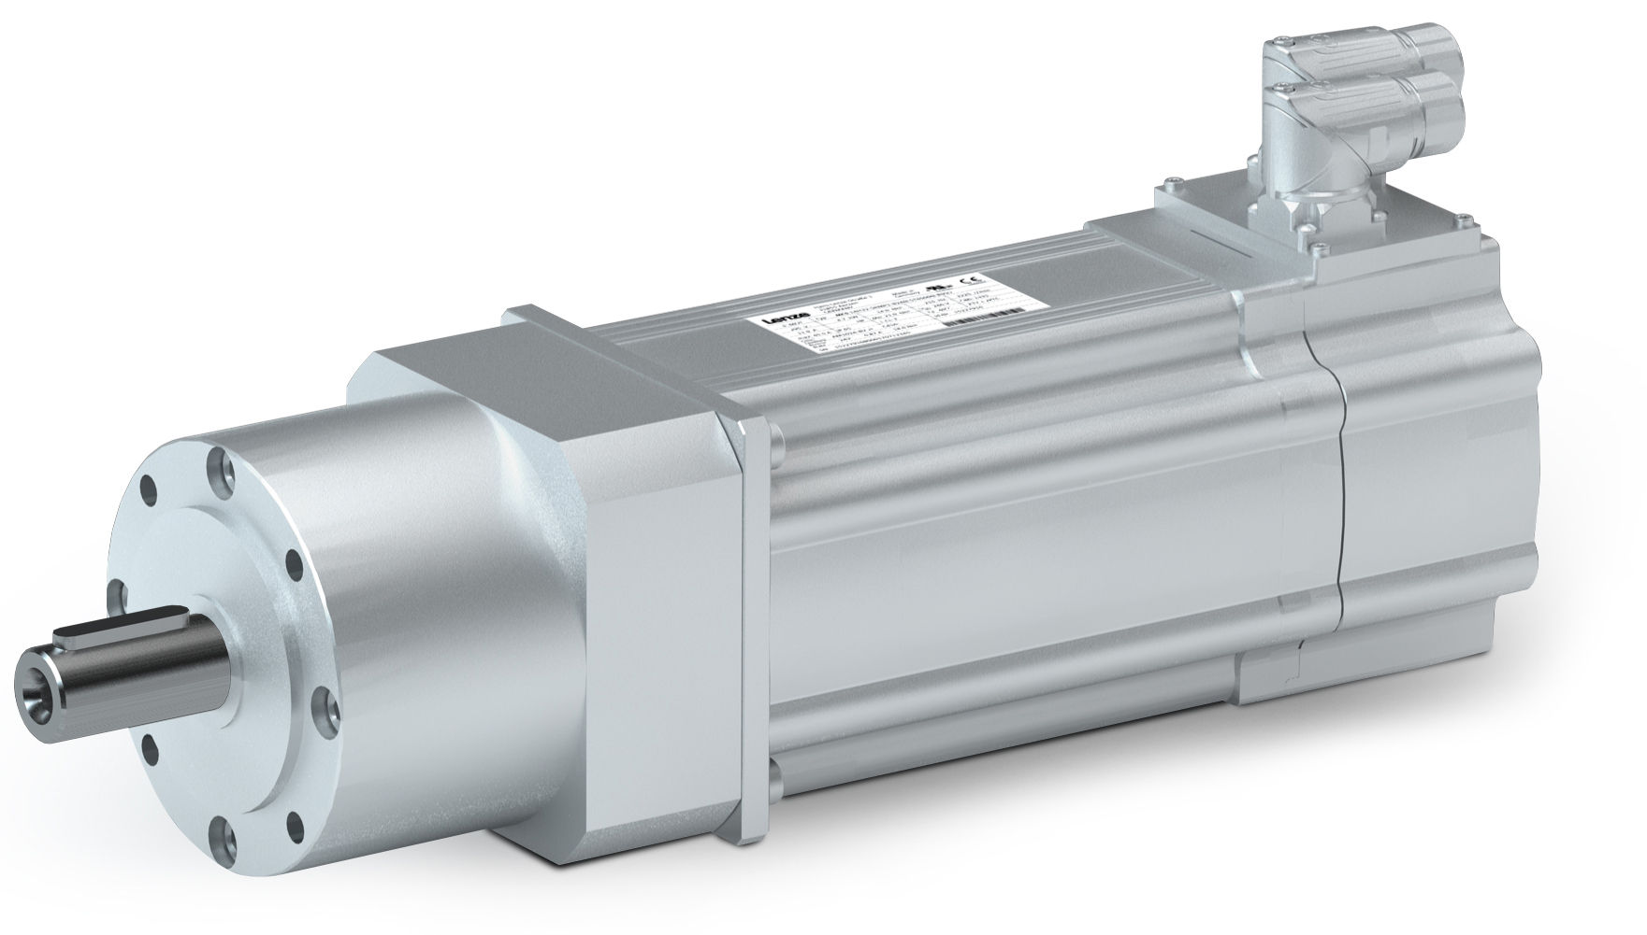

Example program
Object Oriented Programming
The target of the training is generating a filling machine with fixed code (parametrizable) for one transfer conveyor and a configurable number of independent fillers (from 1 to 5) of different types, prepared for reusing code and work sharing between programmers' team
Electric Filler 1
Electric Filler 2
Electric Filler 3
Pneumatic Filler 4
Pneumatic Filler 5
Conveyor

Slide 6

Step 0
Object Oriented Programming
Open Step0 program
Check existing state machine
State Machine

Slide 7
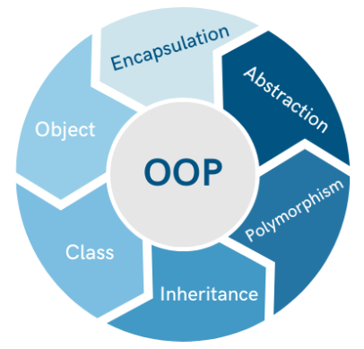
Step 0
Object Oriented Programming
Encapsulation
Modules must not depend on Global Variables
Modules must be commanded through Inputs, Methods or Properties, as simple as possible, with minimum information about internal behavior
Variables are local (privates) by default
State Machine

Slide 8
Step 1
Object Oriented Programming
Generate a new Class (FB) named ClassValve with 3 Methods
AutoStart
AutoStop
Manual
ClassValve
Add Input var diMachineState (DINT) and Output Var xValve (BOOL)
Edit code at AutoStart/AutoStop to activate/deactivate valve
Call methods depending on diMachineState
Generate 3 instances (Objects) of type ClassValve. Connect input to ClassStateMachine and outputs to:
Valve1 (%QX1.0)
Valve2 (%QX1.1)
Valve3 (%QX1.2)

Slide 9
Step 1
Object Oriented Programming
Class and Objects
A Class is a general software module representing the general behavior of a component.
Every instance of a Class is a Object.
Class and Objects

Slide 10
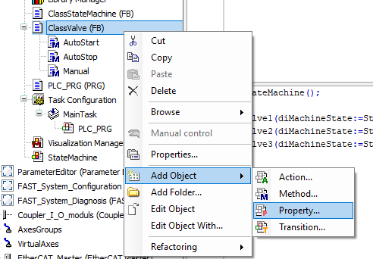
Properties
Object Oriented Programming
Properties:
Properties are special methods for accessing internal variables or internal information
A Property needs a TYPE (BOOL, DINT, LREAL, ENUM, etc…) and generate two special methods called ACCESORS (Get and Set).
Get Accessor (Getter) is executed when the property is read.
Set Accessor (Setter) is executed when the property is written.

Slide 11
Step 2
Object Oriented Programming
Add a TON Timer tVolume and diLitersToTime DINT VAR to ClassValve
Execute tVolume in ClassValve body
Set a default value to diLitersToTime to 1000
Add a property Volume to ClassValve
Properties
DINT type
Get and Set Accessors
Add code to Get and Set accessors
Set accessor to set time depending on diLitersToTime
Get accessor to read actual volume

Slide 12
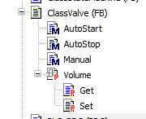
Properties (Step 2)
Object Oriented Programming
Properties:
Properties may have only one accessor, Getter or Setter
If only Get accessor is present, property is READ ONLY
If only Set accessor is present, property is WRITE ONLY

Slide 13
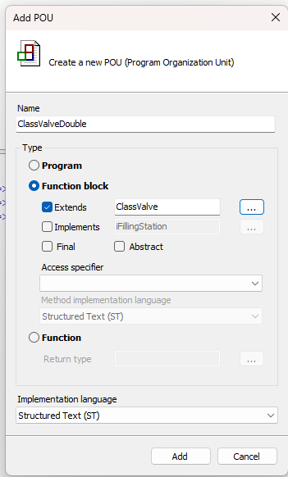
Inheritance (Step 3)
Object Oriented Programming
Inheritance:
Now we need a Valve with two outputs
In traditional programming, we can copy+pase ClassValve to generate a ClassValveDouble, adding the new Output and new functionality.
This traditional programming means duplicating code. If there is an error, error is duplicated. If new feature is introduced, it should be duplicated.
In OOP, we use Inheritance

Slide 14
Inheritance (Step 3)
Object Oriented Programming
Add a new ClassValveDouble inherited from ClassValve
EXTENDS is the key word for inheritance
So far, ClassValveDouble and ClassValve are identicals
Add a new output xValve2 to ClassValveDouble
Inheritance
ClassValveDouble has now two outputs: its xValve2 and the inherited output xValve
Modify code to activate xValve2
Use SUPER pointers to don’t duplicate code!!
SUPER is a pointer to Mother Class

Slide 15
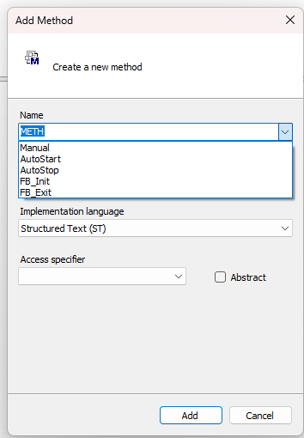
Inheritance (Step 3)
Object Oriented Programming
Override:
If there is Method/Property on Child Class with same name of Mother Class, then this is an Overridden Method/Property
The Overridden Method/Property on Child Class substitute the method with same name on Mother Class
PlcDesigner offers the possibility of easily override Methods and Properties

Slide 16
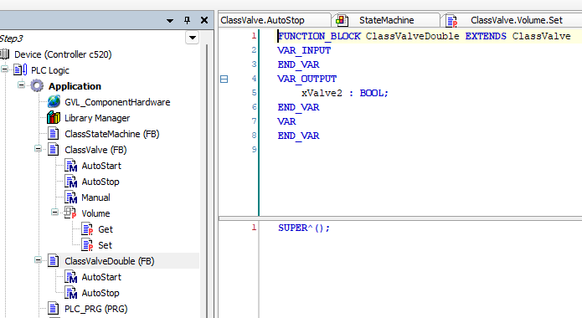
Inheritance (Step 3)
Object Oriented Programming
Override:
SUPER is a pointer to Mother Class. It is used when Child Class should increase functionality of Mother Class and not complete override it
Body code on Mother Class is overridden by default in Child Class. Use SUPER^() to avoid this effect.

Slide 17
Inheritance (Step 3)
Object Oriented Programming
Inheritance
Code should not be repeated. If two modules share the same code, this modules should inherit from a Mother Class.
Mother Class functionality can be extended in child Class by adding more functionality. Mother Class can also be modified by overriding Methods and Properties
Inheritance

Slide 18
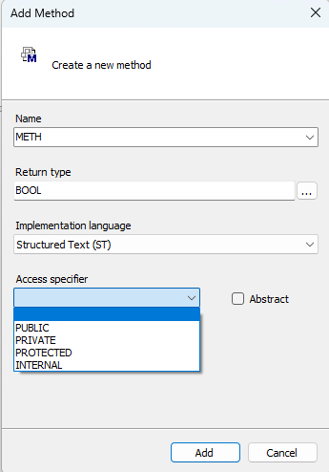
Inheritance – Method access specifier
Object Oriented Programming
Access specifier:
PUBLIC (default). Can be called internally and externally
PRIVATE. Can only be called internally and not from derived classes
PROTECTED. Can only be called internally and from derived classes
INTERNAL. Can only be called within the Namespace (library)

Slide 19
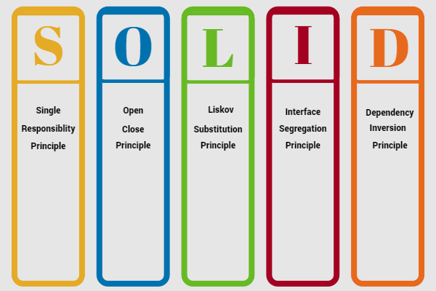
SOLID
Object Oriented Programming
There should never be more than one reason for a class to change. Methods and Properties must handle one and only one functionality.
Open for extension, closed for modification

Slide 20
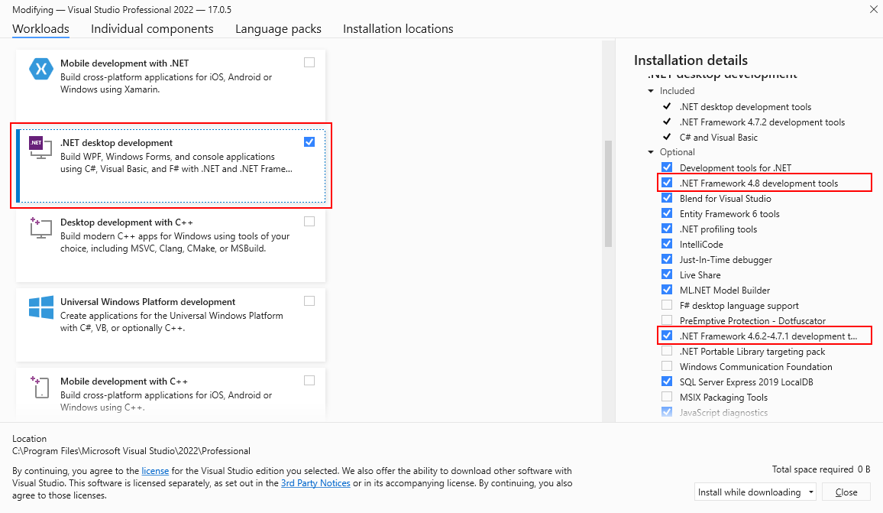
Frameworks
Object Oriented Programming
Frameworks – Visual Studio

Slide 21
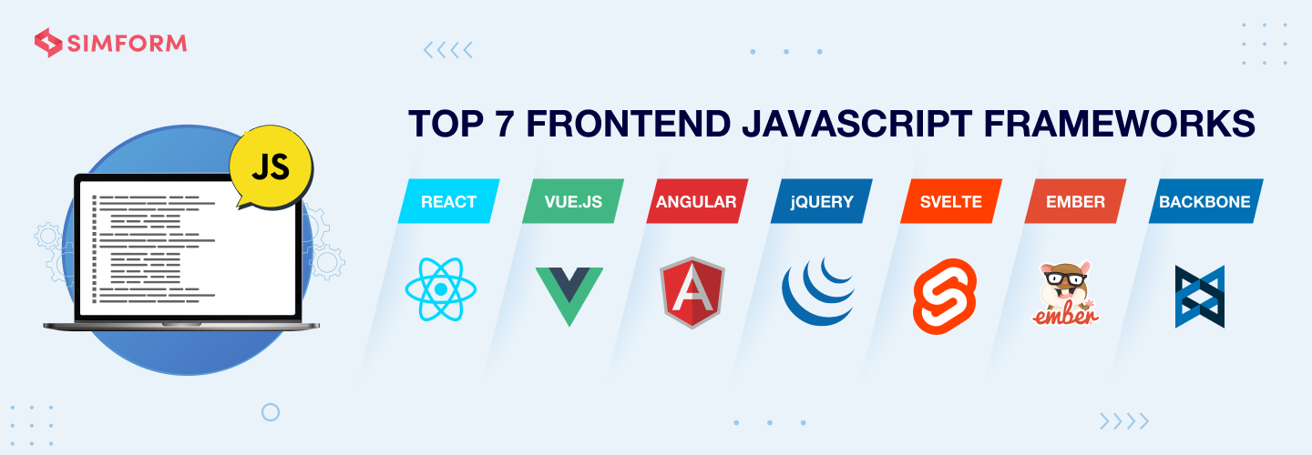
Frameworks
Object Oriented Programming
Frameworks – JavaScript

Slide 22
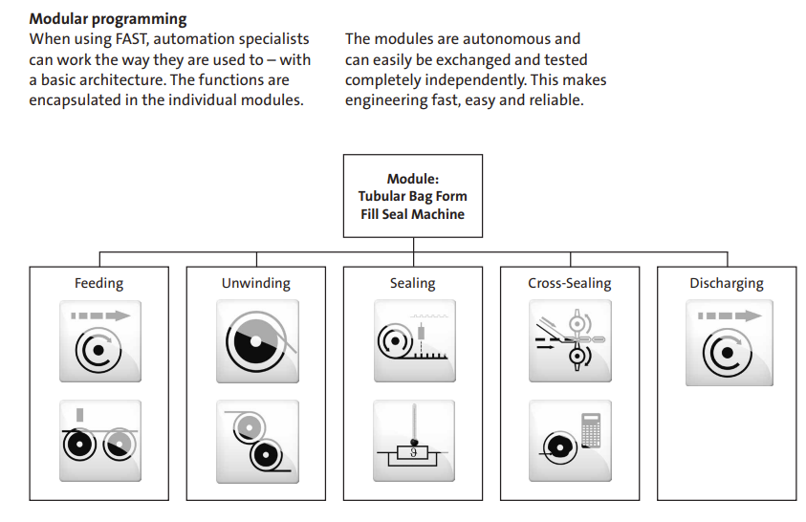
Framework (Step 10)
Object Oriented Programming
Modular programming
Divide machine in UNIT and MODULES
UNIT is the whole machine (Fill Seal Machine)
MODULES are the machine parts (Sealing, Discharging, etc…)

Slide 23
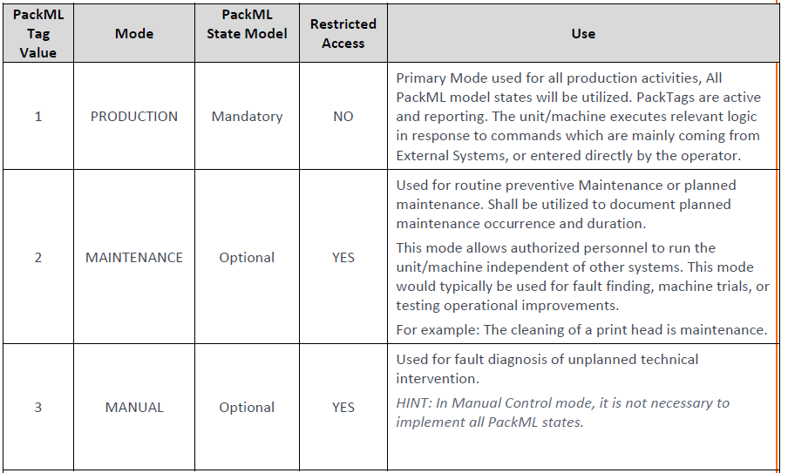
Framework (Step 10)
Object Oriented Programming
PackML
PackML is an international standard based on ANSI/ISA TR88.00.02-2015. PackML standard is an agreement between End Users, OEM and Control Equipment Manufacturers.
PackML standard is based on a control structure dividing the machine functionality in Working Modes and States inside the Working Modes.

Slide 24
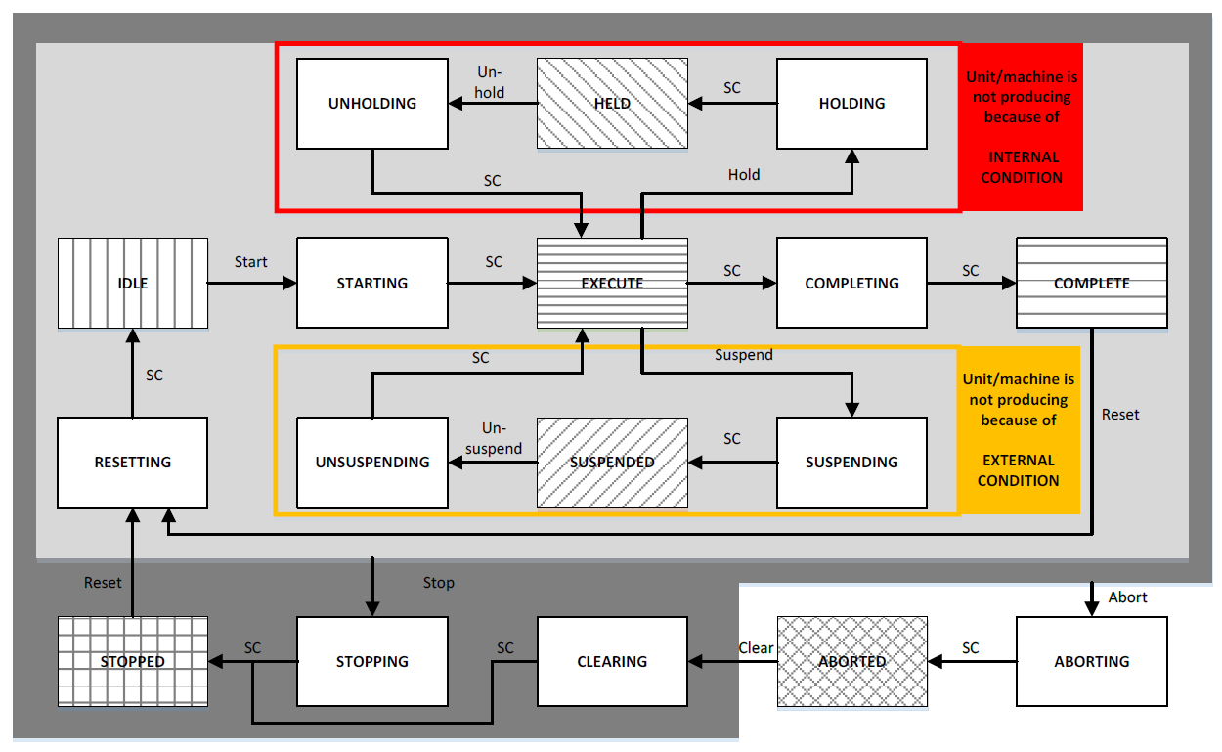
Framework (Step 10)
Object Oriented Programming
PackML
Each working MODE is sub-divided into STATES.
Not all the working modes need to have all the STATES defined on the standard. Normally only PRODUCTION mode has all the possible STATES.

Slide 25
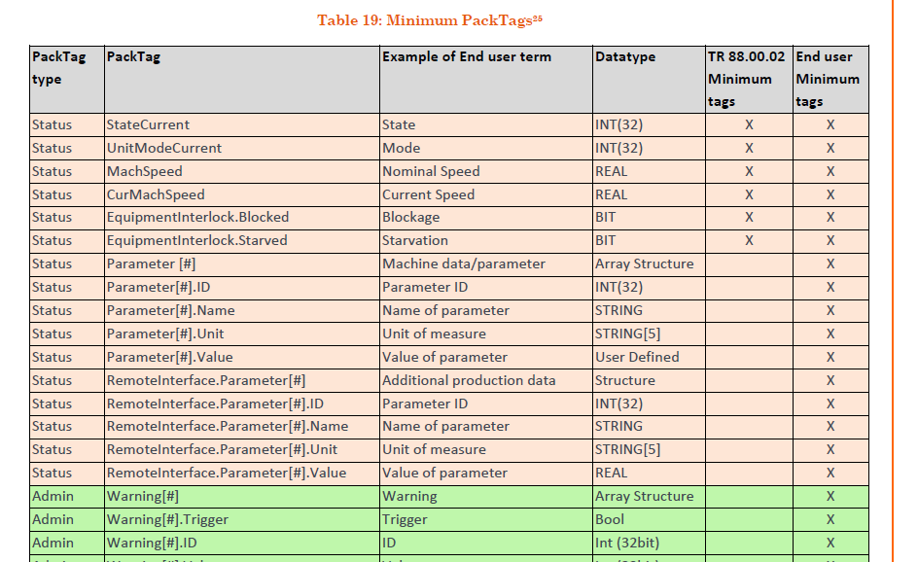
Framework (Step 10)
Object Oriented Programming
PackML - PackTags
PackML compliance machines must have minimum set of standar variables called PackTags
The PackML standatd specifies the name, type and content of every PackTag
OEE variables are included in the standard

Slide 26
Framework (Step 10)
Object Oriented Programming
Open Step0 again
Delete ClassStateMachine, instance and call in PLC_PRG
So far, project has only hardware. Empty software
Add PackMLFramework library
Framework
This library contains the framework
Generate the UNIT - ClassFillingMachine
Generate folder 01_FillingMachine to organize project
ClassFillingMachine must EXTENDS PackMLMachineUnit Class from the library
ClassFillingMachine is a child class from PackMLMachineUnit

Slide 27
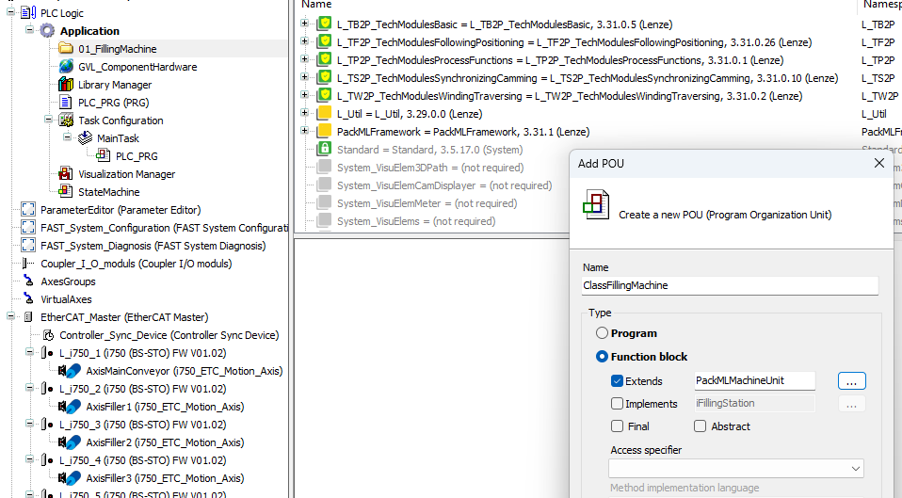
Framework (Step 10)
Object Oriented Programming
Extends is the KEY Word for Inheritance

Slide 28
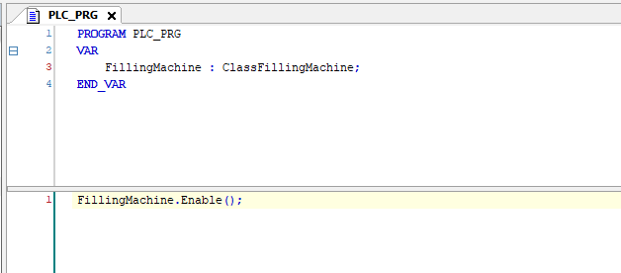
Framework (Step 10)
Object Oriented Programming
Enable() Method of UNIT is the Framework Entry Point
FillingMachine has code inherited from Mother Class

Slide 29
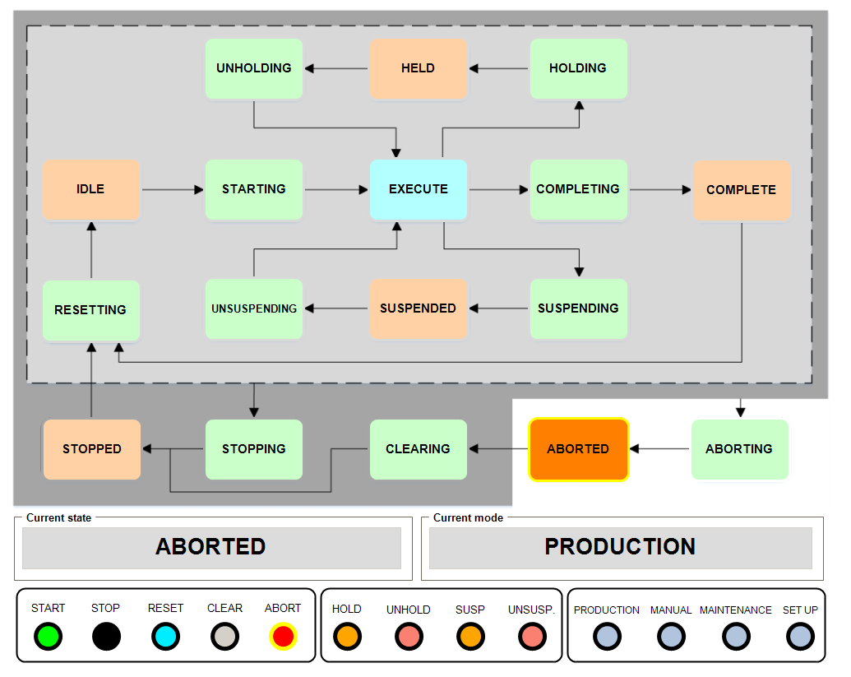
Framework (Step 10)
Object Oriented Programming
PackML State Machine
Check the StateMachine VISU
Download and test
So far, machine has no functionality. We just have the structure

Slide 30
MachineModules (Step 11)
Object Oriented Programming
Generate first Machine Module ClassVentilationSystem
Create folder 02_VentilationSystem
Generate new ClassVentilationSystem inherited from PackMLMachineModule
Add Output xVentilation : BOOL;
Machine Modules
Generate the instance VentilationSystem
Assign constructor parameter Parent to FillingMachine
Override Pro_Resetting for activating the output
Download, test and open Web browser for diagnostic

Slide 31
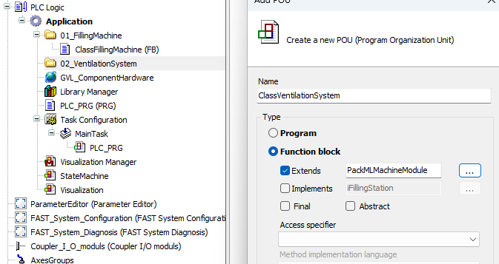
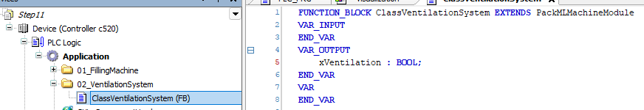
MachineModules (Step 11)
Object Oriented Programming
Machine Modules

Slide 32
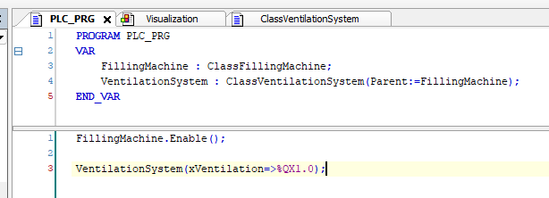
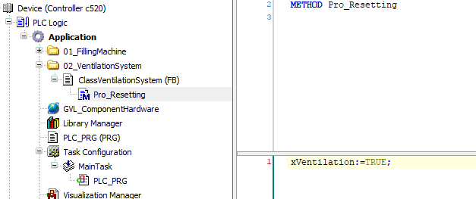
MachineModules (Step 11)
Object Oriented Programming
Machine Modules

Slide 33
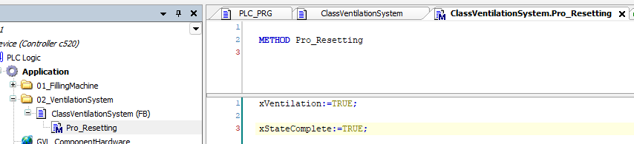
MachineModules (Step 11)
Object Oriented Programming
PackML State Complete
PackML State Machine waits in Resetting STATE until all MODULES finish its functionality on this STATE
To indicate to the framework that STATE functionality is finished, we need to SET to TRUE internal property xStateComplete
Machine Modules

Slide 34
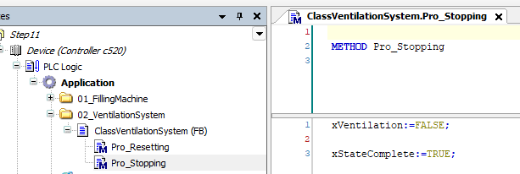
MachineModules (Step 11)
Object Oriented Programming
PackML State Complete
Override Pro_Stopping to deactivate the output xVentilation
Don’t forget xStateComplete to transition to STOPPED
Machine Modules

Slide 35
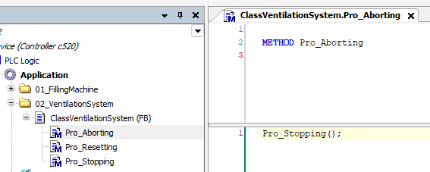
MachineModules (Step 11)
Object Oriented Programming
PackML State Complete
Override Pro_Aborting to program the functionality of the module in case of alarm
Use same functionality of Pro_Stopping without COPY+PASTE!
Machine Modules

Slide 36
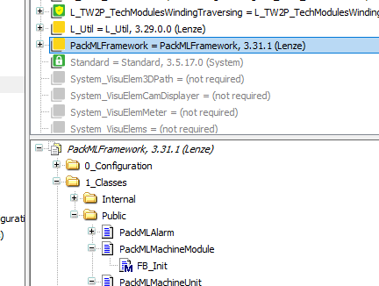
Constructor (FB_Init)
Object Oriented Programming
FB_Init
FB_Init is a special Method from CodeSys
FB_Init is executed automatically (implicitly) at download time (and Reset Warm) before RUN
FB_Init already has parameters and it is possible to add new ones
FB_Init Parameters are set just after Instance name, inside ()

Slide 37
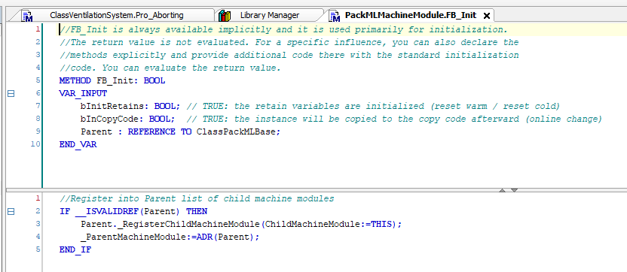
Constructor (FB_Init)
Object Oriented Programming
FB_Init
FB_Init of PackMLMachineModule has an additional parameter call Parent: REFERENCE TO ClassPackMLBase
Class PackMLMachineUnit extends ClassPackMLBase (this is why you can assign FillingMachine to Parent)
All PackMLMachineModules register itself into the PackMLMachineUnit

Slide 38
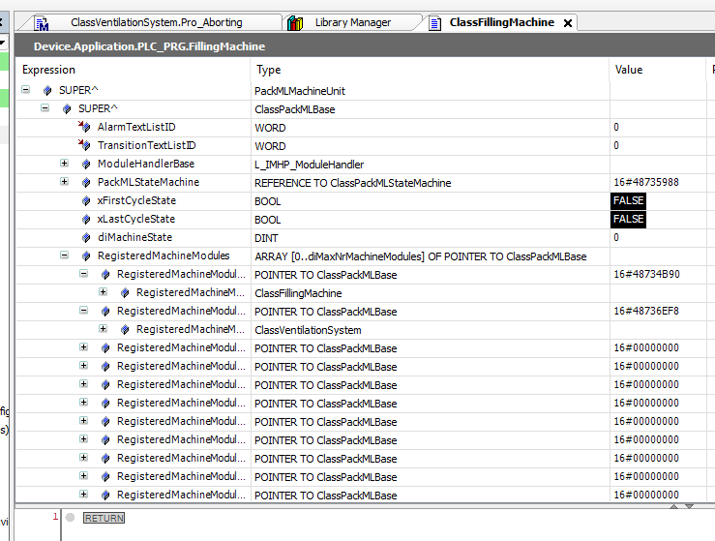
Responsive Design
Object Oriented Programming
Observable
PackMLMachineUnit (in our case FillingMachine) has a list of all the modules registered to it
FillingMachine holds PackML the State Machine
FillingMachine calls internally the right method on the Modules depending on the PackML MODE and STATE
In MODE Production, STATE Resetting, it calls all the Pro_Resetting() of its registered modules
FillingMachine is the Observable. Modules are the Observers
Observers responds to Observable changes

Slide 39
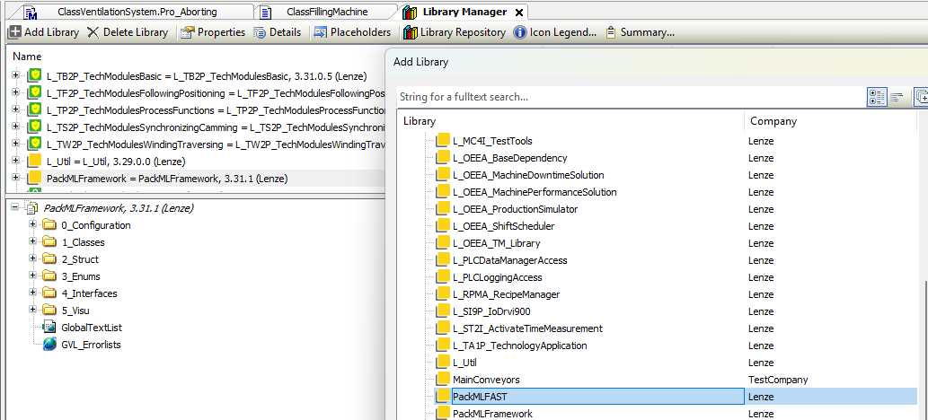
MachineModules (Step 12)
Object Oriented Programming
Module Main Conveyor
Main Conveyor module will control an AXIS
Main Conveyor will have to perform HOMING, JOG, MOVEABS, Diagnostics, etc…
Instead of generating ClassMainConveyor from PackMLMachineModule we will use PackMLBasicMotionBase from PackMLFAST library
Machine Modules

Slide 40
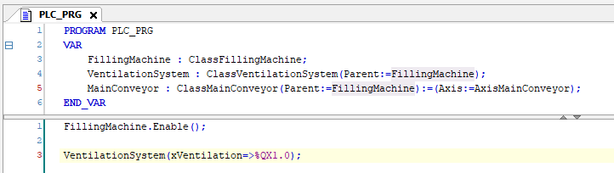
MachineModules (Step 12)
Object Oriented Programming
Module Main Conveyor
Generate folder 03_MainConveyor
Generate ClassMainConveyor extending from PackMLBasicMotionBase
Generate instance MainConveyor and assign the AXIS input and parent in the constructor (FB_Init)
Machine Modules

Slide 41
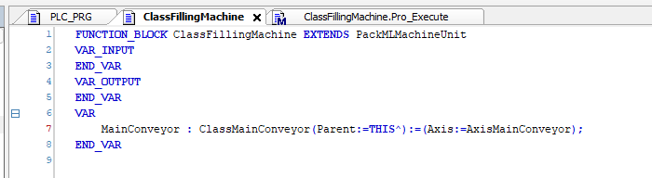
MachineModules (Step 12)
Object Oriented Programming
Automatic cycle into FillingMachine
Override Pro_Execute method in ClassFillingMachine
Into Pro_Execute program a MoveRel of 360 degrees of MainConveyor
To give orders to MainConveyor, MainConveyor must accessible. We can simply create a Global Variable list to define all modules -> it breaks encapsulation.
Instead, we will move MainConveyor to internal vars. But then, what is the name of the parent?
Machine Modules

Slide 42
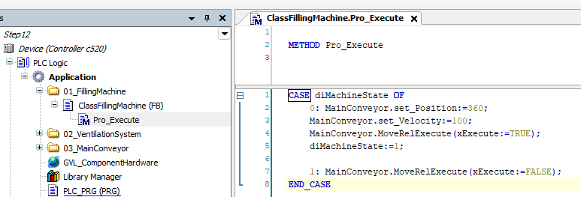
MachineModules (Step 12)
Object Oriented Programming
Automatic cycle into FillingMachine
Introduce code into Pro_Execute method in ClassFillingMachine
diMachineState is an internal framework variable. It is set to 0 every transition of STATE
Useful for using in CASE sentences. It will be 0 every first scan after changing STATE
Machine Modules

Slide 43
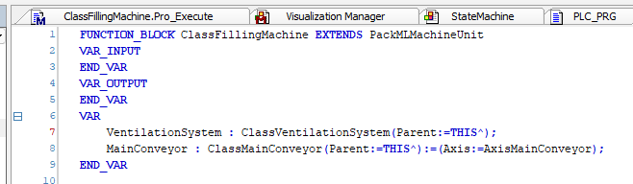
Global IO assigment – VAR_CONFIG (Step 13)
Object Oriented Programming
Change VentilationSystem to internal variable
Change VentilationSystem as internal variable and assign Parent with pointer THIS
VAR_CONFIG

Slide 44
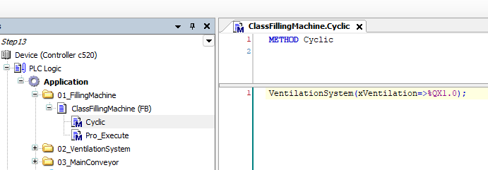
Global IO assigment – VAR_CONFIG (Step 13)
Object Oriented Programming
Change VentilationSystem to internal variable
We need to change the OUTPUT assignment, as VentilationSystem is not part of PLC_PRG anymore
For this, we can use Cyclic() method. This Method is called by the framework every scan cycle unconditionally
VAR_CONFIG

Slide 45
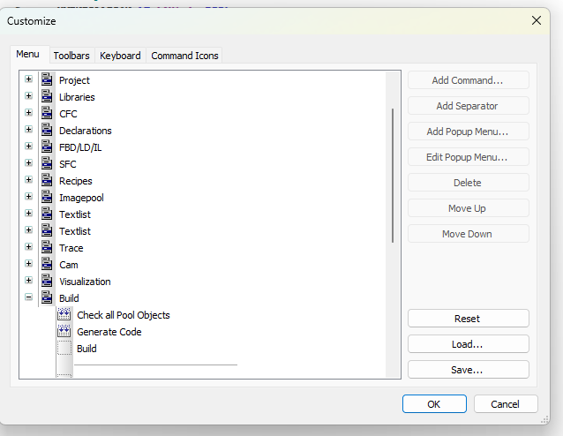
Global IO assigment – VAR_CONFIG (Step 13)
Object Oriented Programming
Change VentilationSystem to internal variable
Generate Gloval Variable list named IOConfiguration
Change type of xVentilation output to %Q* : BOOL;
There is a BUG!!! on PLCDesigner!!!
Go to TOOLS menu, option Customize
Select any empty space in Build menu

Slide 46
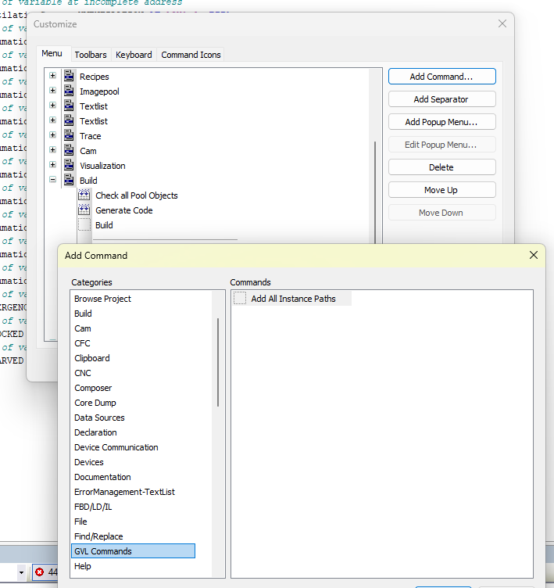
Global IO assigment – VAR_CONFIG (Step 13)
Object Oriented Programming
Global assignment of IOS
Generate Gloval Variable list named IOConfiguration
Change type of xVentilation output to %Q* : BOOL;
There is a BUG!!! on PLCDesigner!!!
Go to TOOLS menu, option Customize
Select any empty space in Build menu
Click Add Command… button and from GVL Commands select “Add All Instance Paths”

Slide 47
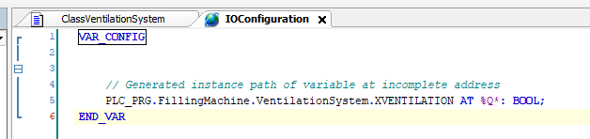

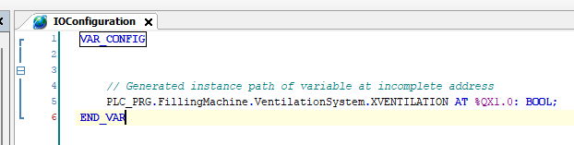
Global IO assigment – VAR_CONFIG (Step 13)
Object Oriented Programming
Global assignment of IOS
Open IOConfiguration GVL list
Build your project (F11). Not Build All!!!! If you select Build All or the button you will get errors
Go to Build menu and select “Add All Instance Paths”
Assign the %QX1.0 to your output

Slide 48
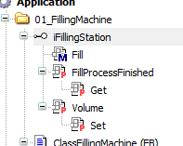
Interfaces (Step 14)
Object Oriented Programming
Interfaces
We want to generate a generic code for every kind of FillingStations (pneumatic, electric, etc…)
For this, generate an Interface named iFillingStation
The interface is the prototype for all Methods and Properties all FillingStation must have
Method Fill will have input xExecute
FillProcessFinished, READ_ONLY, type BOOL
Volume, WRITE_ONLY, type LREAL
Generate a variable FillingStations Array[1..5] of iFillingStation on ClassFillingMachine
For testing, add Volumes variable as Array[1..5] of LREAL
Open Step14!!

Slide 49
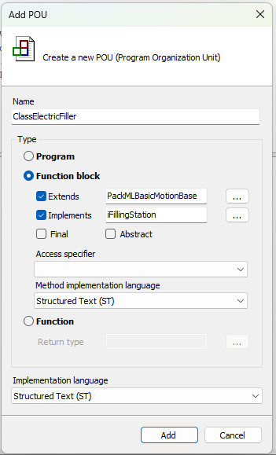
Interfaces - ElectricFiller (Step 15)
Object Oriented Programming
Interfaces – Electric Filler
We will generate our first type of Filling Station. It will be the ElectricFiller
Generate folder 04_ElectricFiller
Generate ClassElectricFiller. The ElectricFiller inherits from PackMLBasicMotionBase (it will control an AXIS in positioning mode) but also is a FillingStation, so it must IMPLEMENT iFillingStation
Delete all Methods for Production and Manual

Slide 50
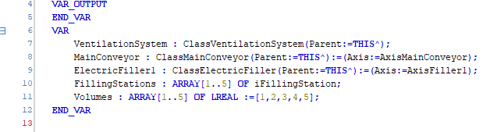
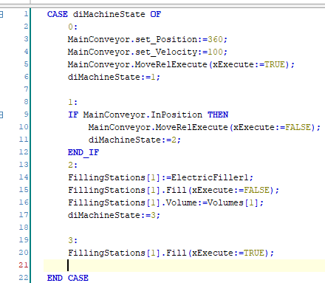
Interfaces - ElectricFiller (Step 15)
Object Oriented Programming
Interfaces – Electric Filler
Generate instance ElectricFiller1 of type ClassElectricFiller and assign parameters
Modify FillingMachine Pro_Execute() to execute one cycle
FillingStations[1] can be assigned to ElectrifFiller1 as FillingStations is of type iFillingStation and ElectricFiller1 IMPLEMENTS iFillingStation

Slide 51
Abstraction
Object Oriented Programming
Abstraction
Every Class must show to external world only its minimum Methods and Properties to be handled. All other Methods, Properties, Variables must be internal. Internal complexity is hidden.
Interfaces helps in abstraction. Interfaces publish only the minimum required Methods and Properties
Abstraction

Slide 52
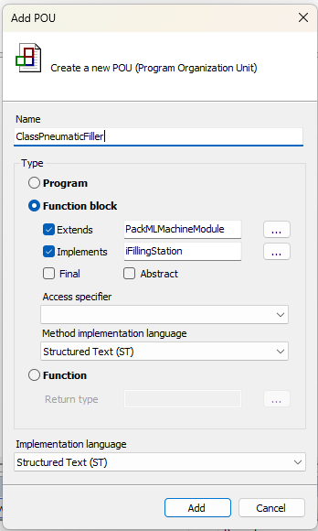
Interfaces - PneumaticFiller (Step 16)
Object Oriented Programming
Interfaces – Pneumatic Filler
We will generate our second type of Filling Station. It will be the PneumaticFiller
Generate folder 05_PneumaticFiller
Generate ClassPneumaticFiller. The PneumaticFiller inherits from PackMLMachineModule but also is a FillingStation, so it must IMPLEMENT iFillingStation
Delete all Methods for Production and Manual

Slide 53
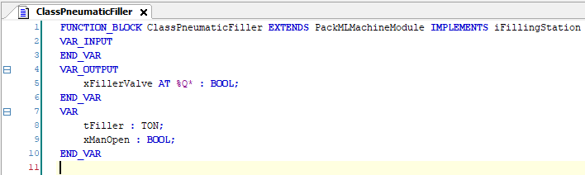
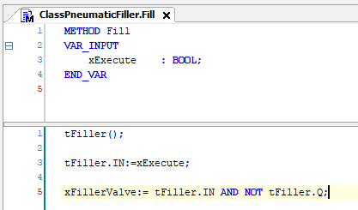
Interfaces - PneumaticFiller (Step 16)
Object Oriented Programming
Interfaces – Pneumatic Filler
Generate variables for ClassPneumaticFiller
Generate code for Fill() Method

Slide 54
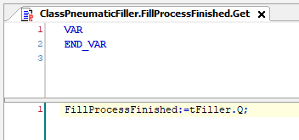
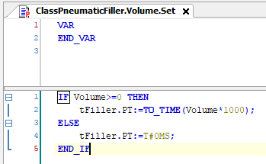
Interfaces - PneumaticFiller (Step 16)
Object Oriented Programming
Interfaces – Pneumatic Filler
Generate code for FillProcessFinished Property.
Generate code for Volume Property

Slide 55
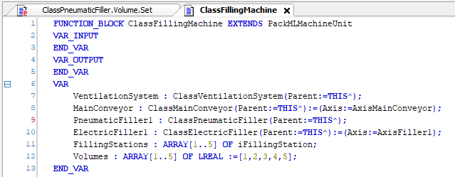
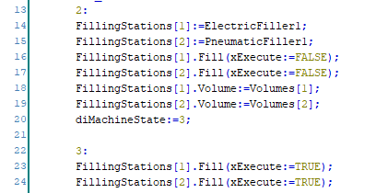
Interfaces - PneumaticFiller (Step 16)
Object Oriented Programming
Interfaces – Pneumatic Filler
Generate first instance PneumaticFiller1
Modify FillingMachine Pro_Execute()

Slide 56

Interfaces - PneumaticFiller (Step 16)
Object Oriented Programming
Interfaces – Pneumatic Filler
Remember to Build (only build, not Generate code) and assign xFillerValve

Slide 57

Common Behaviour Model (Step 17)
Object Oriented Programming
Common Behaviour Model
Pneumatic filler has some issues:
If PackML goes to STOP-ABORT, it does not switch off the output
If PackML goes to SUSPEND-HOLD, timer is not working
The reason is Fill method must be called all the time for the Fill process to work
This is different than Fill on ElectricFiller
Fill Method on Pneumatic Filler is not following the CBM. It is an Enable behavior instead of an Execute behavior

Slide 58

Common Behaviour Model (Step 17)
Object Oriented Programming

Slide 59


Common Behaviour Model (Step 17)
Object Oriented Programming

Slide 60


Common Behaviour Model (Step 17)
Object Oriented Programming
Common Behaviour Model
Override Cyclic method on PneumaticFiller
Modify Fill method to be CBM Execute compliant

Slide 61


Common Behaviour Model (Step 17)
Object Oriented Programming
Common Behaviour Model
Now override Pro_Stopping and Pro_Aborting to stop Fill process in PneumaticFiller

Slide 62

Interfaces (Step 18)
Object Oriented Programming
Implement interfaces
Now we are going to program the Manual behavior for PneumaticFiller
Fir this, IMPLEMENTS the itfManual INTERFACE from PackMLFramework
PLCDesigner (all CodeSys based systems) does not allow multiple inheritance. There can be only one Mother Class
As many high level languages, multiple inheritance is not allowed
Opposite, a Class may implement several INTERFACES

Slide 63

Interfaces (Step 18)
Object Oriented Programming
Implement interfaces
Now we are going to program the Manual behavior for PneumaticFiller
Fir this, IMPLEMENTS the itfManual INTERFACE from PackMLFramework
PLCDesigner (all CodeSys based systems) does not allow multiple inheritance. There can be only one Mother Class
As many high level languages, multiple inheritance is not allowed
Opposite, a Class may implement several INTERFACES

Slide 64

Interfaces (Step 18)
Object Oriented Programming
Implement interfaces
In PackMLFramework there are several INTERFACES prepared
Implement Interfaces… option from PLCDesigner inform about all the Methods and Properties which MUST be implemented by IMPLEMENTING the interfaces

Slide 65


Interfaces (Step 18)
Object Oriented Programming
Implement interfaces
In PackMLFramework there are several INTERFACES prepared
Implement Interfaces… option from PLCDesigner inform about all the Methods and Properties which MUST be implemented by IMPLEMENTING the interfaces

Slide 66

UML
Object Oriented Programming

Slide 67
SOLID
Object Oriented Programming
Don’t make modules depend on interfaces they don’t use
Split functionality in several little interfaces instead of a big one with Methods and Properties you will not use
“High-level modules should not depend on low-level modules. Both should depend on abstractions
”

Slide 68
SOLID
Object Oriented Programming
“objects of a superclass shall be replaceable with objects of its subclasses without breaking the application”

Slide 69



Interfaces – Cast - QueryInterface
Object Oriented Programming
Cast
Cast is checking the type of the module. In other words, casting is asking the module which functionality has
If you know the functionality, you can call it depending on your conditions
This is useful for optional functionalities.
Cast is done in PLCDesigner with __QUERYINTERFACE operator
For __QUERYINTERFACE to work the interfaces to be CAST must EXTENDS __SYSTEM.IQueryInterface

Slide 70


Interfaces (Step 20)
Object Oriented Programming
Assign Interfaces
Open Step20 directly
Look at eConfigFiller ENUM and DUTConfigFillingMachine STRUCT

Slide 71

Interfaces (Step 20)
Object Oriented Programming
Assign Interfaces
Configuration of FillingMachine is stored on persistent vars

Slide 72
Polymorphism
Object Oriented Programming
Polymorphism
Interfaces allow Polymorphism. Every Class implementing the same interface may implement the functionality in a completely different way
Interfaces also help in Open-Close Principle. Making a genera main application using interfaces allow to add new types implementing the same interface without modifying general program.
Polymorphism

Slide 73

Interfaces (Step 20)
Object Oriented Programming
Assign Interfaces
Pro_Execute Method has been increased fo met the Open-Close Principle -> it will be the same independently of the number and type of FillingStations

Slide 74

Interfaces (Step 20)
Object Oriented Programming
Assign Interfaces
Init Method has been added to execute the Method ResetMachineModules() when requested on HMI

Slide 75
INTERNAL Methods
Object Oriented Programming
INTERNAL Methods
INTERNAL Methods can only be called inside the library they are defined
INTERNAL modified is useful to prevent overriding of this method in inherited classes, as the functionality is internal to the framework (library)
INTERNAL modified can be combined with the CodeSys attribute ‘hide’. With this attribute, the Method is not visible when programming

Slide 76

ABSTRACT Classes
Object Oriented Programming
ABSTRACT
ABSTRACT Classes can not be instantiated. They are just prototype of a Class
ABSTRACT Classes may have ABSTRACT Methods and/or Properties
If a Class has an ABSTRACT Methods or Property, then the Class is ABSTRACT

Slide 77

ABSTRACT Classes
Object Oriented Programming
ABSTRACT – Real application
Let’s have a Palletizer with a gripper with two axes, U and W
Both axes compress the pieces and hold then.
X-Y-Z-C axes take the piece from Pick position to Place position, while U-W hold the piece
Holding process (Close gripper process) may have different sequences, stored in a recipe system
Every sequence has several steps. CloseU, RelaxU, CloseW, RelaxW, CloseU again, etc… depending on the kind of piece
U-W axes can be Electric (servo drive) or hydraulic.
We don’t want to repeat the sequence program per every kind of axis, electric or hydraulic

Slide 78



ABSTRACT Classes
Object Oriented Programming
ABSTRACT – Real application
An intermediate ClassGenericGripper is created as ABSTRACT
On ClassGenericGripper are defined several ABSTRACT methods

Slide 79

ABSTRACT Classes
Object Oriented Programming
ABSTRACT – Real application
In ClassGenericGripper, the sequences are programmed.
Sequences are stored in standard Methods.
The standard Methods call ABSTRACT methods, which are so far not defined

Slide 80



ABSTRACT Classes
Object Oriented Programming
ABSTRACT – Real application
Two real Classes INHERITS from ClassGenericGripper: ClassGripperElectricDouble and ClassHydraulicGripper
These two Classes implements the real functionality of the ABSTRACT Methods. Every Class implement the ABSTRACT Methods in different way (Polymorphism)
ABSTRACT Classes are similar to INTERFACES, but they allow code inside, not just prototyopes.
INTERFACES and ABSTRACT Classes can be combined (in fact, this is a typical strategy)

Slide 81

PackMLFramework – Alarms (Step 21)
Object Oriented Programming
Alarms
Alarms are instances of Class PackMLAlarm
As input parameter it has the TextId number (PackML Alarms use LEM and LMH in the background)
Generate INPUT xEmergencyStop to trigger digital alarm and Object AlarmEmergencyStop of type PackMLAlarm
TextID will be number 1

Slide 82


PackMLFramework – Alarms (Step 21)
Object Oriented Programming
Alarms
Generate ErrorManagement – Text List with name AlarmsFillingMachine
Generate TextId number 1 with text Emergency Stop
Override ErrorManagement() Method with the code of the picture to activate alarm
Alarms can be by bit of by value; alarms by value triggers different alarms depending on the value -> can be used for Stop Reasons in OEE calculation

Slide 83

PackMLFramework – Alarms (Step 21)
Object Oriented Programming
Alarms
Assign AlarmsFillingMachine to input of FillingMachine

Slide 84

Final modifier
Object Oriented Programming
Alarms
A Class is designed as Final can not be extended.
Final Classes can not be inherited
In PackMLFramework, if Class PackMLAlarm is extended and Monitor method is overridden, then alarm is not working
To prevent this situations, PackMLAlarm should have been set as Final (it will be in next release)

Slide 85


PackMLFramework – Transitions (Step 22)
Object Oriented Programming
Transitions
If input xLowLevel is FALSE, Pneumatic filler can not transition from RESETTING to IDLE and there must be corresponding diagnostic
Generate INPUT xLowLevel
Override Pro_Resetting with picture code
VAR_INST are variables inside a Method which are not initialized at every call. Standard VAR are initialized every call -> NEVER use timers, R_TRIG

Slide 86


PackMLFramework – Transitions (Step 22)
Object Oriented Programming
Transitions
If input xLowLevel is FALSE, Pneumatic filler can not transition from RESETTING to IDLE and there must be corresponding diagnostic
Generate INPUT xLowLevel
Override Pro_Resetting with picture code
Generate ErrorManagementTextList named TranPneumaticFiller with TextId 1 Low Level
Assign this TranPneumaticFiller list to input TransitionTextListID

Slide 87

PackMLFramework – Suspending (Step 23)
Object Oriented Programming
Suspending
Open Step23 directly
FillingMachine has been adapted to continue the automatic cycle in Execute but also in Holding and Suspending
In Resetting the cycle is reset
We want to stop the cycle in case of Starved situation (previous machine) and Blocked situation (next machine), going to Suspended STATE

Slide 88


PackMLFramework – Suspending (Step 24)
Object Oriented Programming
Suspending
Add inputs xBlocked and xStarved
Add picture code to ErrorManagement Method
WarningBlocked and WarningStarved are already defined in Mother Class PackMLMachineUnit

Slide 89


PackMLFramework – Holding (Step 25)
Object Oriented Programming
Holding
If automatic cycle is started (EXECUTE) and input xLowLevel at PneumaticFiller is TRUE then HOLDING state must be triggered
Add WarningLevel Class of type PackMLAlarm.
This PackMLAlarm is of type eAlarmType:=Hold, with TextID number 1
Override ErrorManagement

Slide 90


PackMLFramework – Holding (Step 25)
Object Oriented Programming
Holding
Add ErrorManagement-TextList named AlarmPneumaticFiller with text ID number 1 “Low level”
Assign AlarmPneumaticFiller to ClassPneumaticFiller instances

Slide 91
Muchas Gracias

